Slide 1
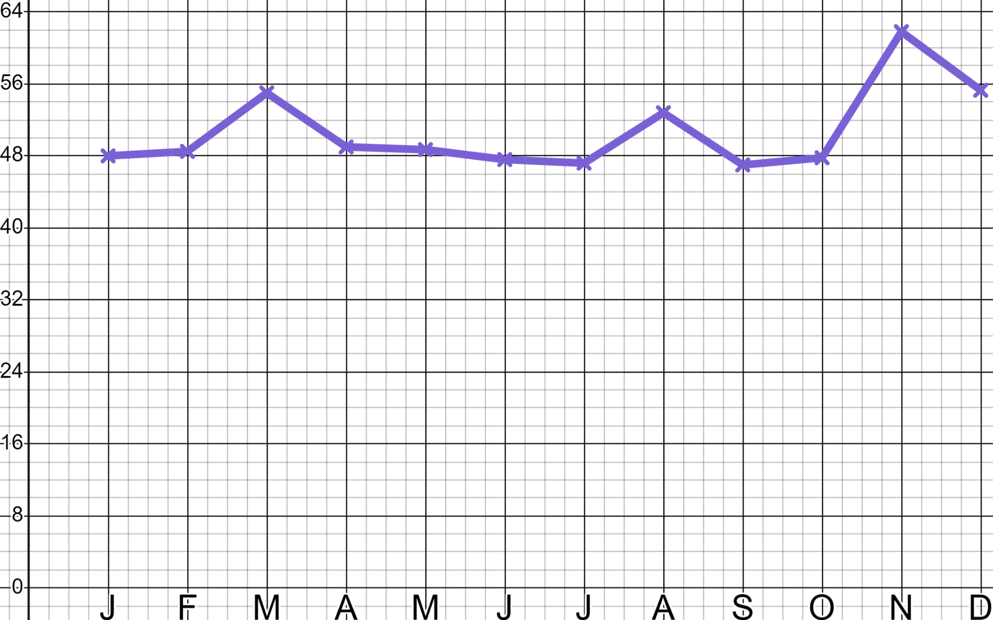
Sales and marketing
Task A: Maths in marketing
1) ‘Sam’s Sleepwear’ is now well established in the bedwear marketplace. On three occasions in this year they spent just under £5000 on online advertising campaigns.
When were those campaigns?
Which one was the most effective?
How do you know?
Site visits (000’s)
Month
You might have said:
“The advertising campaigns happened in March, August and November.”
“We know that the November campaign was the most effective one because it resulted in the greatest ‘spike’(increase) in site visits.”

Slide 2
Sales and marketing
2) ‘Sam’s Sleepwear’ is now well established in the bedwear marketplace. They spend the below on advertising and generate 14 000 extra visitors to their website.
YouTube advert
(28%)
YouTube £1100
Direct email £350
Facebook £500
Google £2500
Google
advert
(38%)
They now make a sale from 1 in 40
visitors and an average of £14 per sale.
Facebook advert
(16%)
Direct email
(18%)
Direct email
(18%)
Calculate which form of media is the most profitable and advise Sam as to where to spend their next advertising budget.
YouTube £1100
Facebook £500
0.28 × 14 000 = 3920 visitors
0.16 × 14 000 = 2240 visitors
£1100 ÷ 3920 = £0.28… per visit
£500 ÷ 2240 = £0.22… per visit
£0.28… × 40 = £11.22… per sale
£0.22… × 40 = £8.92… per sale
£14 − £11.22… ≈ £2.78 profit
£14 − £8.92… ≈ £5.07 profit
Direct email £350
Google £2500
0.18 × 14 000 = 2520 visitors
0.38 × 14 000 = 5320 visitors
£350 ÷ 2520 = £0.13… per visit
£2500 ÷ 5320 = £0.46… per visit
£0.13… × 40 = £5.55… per sale
£0.46… × 40 = £18.79… per sale
£14 − £5.55… ≈ £8.44 profit
£14 − £18.79… ≈ £4.80 loss
You might have said:
“Google is expensive and currently unprofitable for a business of your size.”
“Direct email campaigns remain the most profitable form of advertising for your business, your market.”
“You spent more than seven times £350 advertising on Google. Perhaps redirect that money and do more direct email campaigns.”
“YouTube and Facebook are both more expensive and less profitable than direct email but, they still make a profit and give your brand/business good exposure so continue to invest in these.”

Slide 3

Sales and marketing
Task B: Maths in sales
1) Jun is CEO of a sweet manufacturer that sold 36 000 packets of sweets last year at £1.80 a packet. Their manufacturing cost is £0.60 per unit.
a) Calculate Jun’s current revenue and profit.
36 000 packets
Selling price: £1.80
Cost price: £0.60
Revenue: 36 000 × £1.80 = £64 800
Costs: 36 000 × £0.60 = £21 600
Profit = £64 800 − £21 600 = £43 200
b) If Jun could double his sales by halving his price should he?
72 000 packets
You might have said, “Whilst this will increase volume and market share it halves your profit so I recommend you don’t”.
Selling price: £0.90
Cost price: £0.60
Revenue: 72 000 × £0.90 = £64 800
Costs: 72 000 × £0.60 = £43 200
Profit = £64 800 − £43 200 = £21 600
c) If Jun could increase his sales by a third by reducing his price by one third should he?
48 000 packets
You might have said, “Whilst this will increase volume and market share it will reduce profit by one third so I recommend you don’t”.
Selling price: £1.20
Cost price: £0.60
Revenue: 48 000 × £1.20 = £57 600
Costs: 48 000 × £0.60 = £28 800
Profit = £57 600 − £28 800 = £28 800

Slide 4



Sales and marketing
2) Andeep is a commercial accountant for a guitar manufacturer that sells 1200 units a year at £600 per unit and costs £480 per unit to make.
Which of the below are good commercial deals?
Current:
1200 guitars
Selling price: £600
Cost price: £480
Revenue: 1200 × £600 = £720 000
Costs: 1200 × £480 = £576 000
Profit: £144 000
a) 5% uplift in sales for a 10% drop in price?
1260 guitars
Selling price: £540
Cost price: £480
Revenue: 1260 × £540 = £680 400
Costs: 1260 × £480 = £604 800
Profit: £75 600
b) 50% uplift in sales for a 15% drop in price?
1800 guitars
Selling price: £510
Cost price: £480
Revenue: 1800 × £510 = £918 000
Costs: 1800 × £480 = £864 000
Profit: £54 000
c) 10% drop in sales for a 5% increase in price?
1080 guitars
Selling price: £630
Cost price: £480
Revenue: 1080 × £630 = £680 400
Costs: 1080 × £480 = £518 400
Profit: £162 000
d) If Andeep were to drop his price by 12% what percent uplift in sales would he need to see to maintain his existing profit?
Current total profit: £144 000
£144 000 ÷ £48 = 3000 units
They would need to see a 150% increase in sales to achieve the same profit.
New price: £600 × 0.88 = £528
3000 ÷ 1200 = 2.5 = 250%
New profit per unit: £528 − £480 = £48
Mathematics in Education and Industry
v2.4

